Slide 1
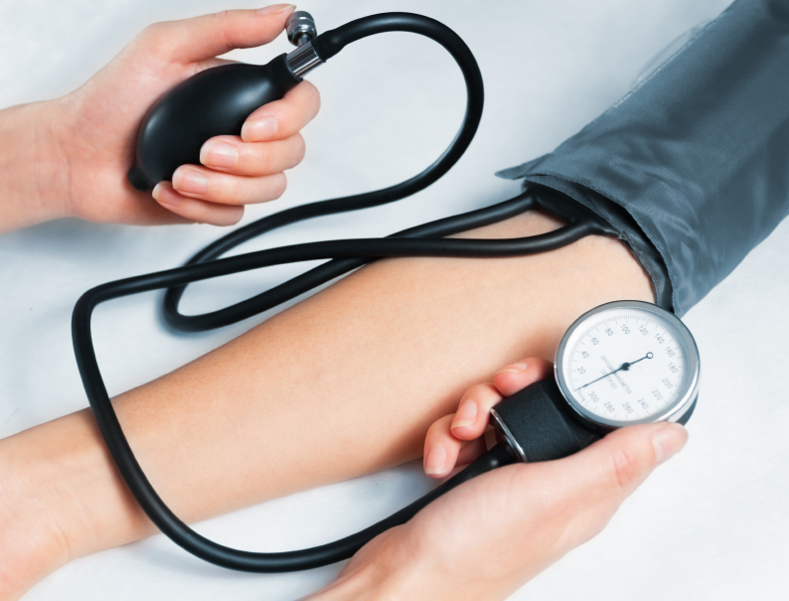
Patient Health Test Analysis
Health Monitoring Dashboard
Name: Manahel Ansari
Roll no: 5121101
Semester: 5th
Department: Center of Data Science
Submitted to: Mam Rabia Shahid

Slide 2
Overview of Data
ID: index
gender
age: 5-years gap
height(cm)
weight(kg)
waist(cm) : Waist circumference length
eyesight(left)
eyesight(right)
hearing(left)
hearing(right)
systolic: Blood pressure (mm Hg)
relaxation: Blood pressure (mm Hg)
fasting blood sugar

Slide 3
Overview of Data
Cholesterol: total (mg/dl)
triglyceride
HDL: cholesterol type
LDL: cholesterol type
hemoglobin
Urine protein
serum creatinine
AST : glutamic oxaloacetic transaminase type
ALT : glutamic oxaloacetic transaminase type
Gtp: γ-GTP
oral: Oral Examination status
dental caries
tartar : tartar status

Slide 4

DAX Queries
Data Analysis Expressions (DAX) is a formula expression language used in Analysis Services, Power BI, and Power Pivot in Excel.
DAX formulas include functions, operators, and values to perform advanced calculations and queries on data in related tables and columns in tabular data models.

Slide 5
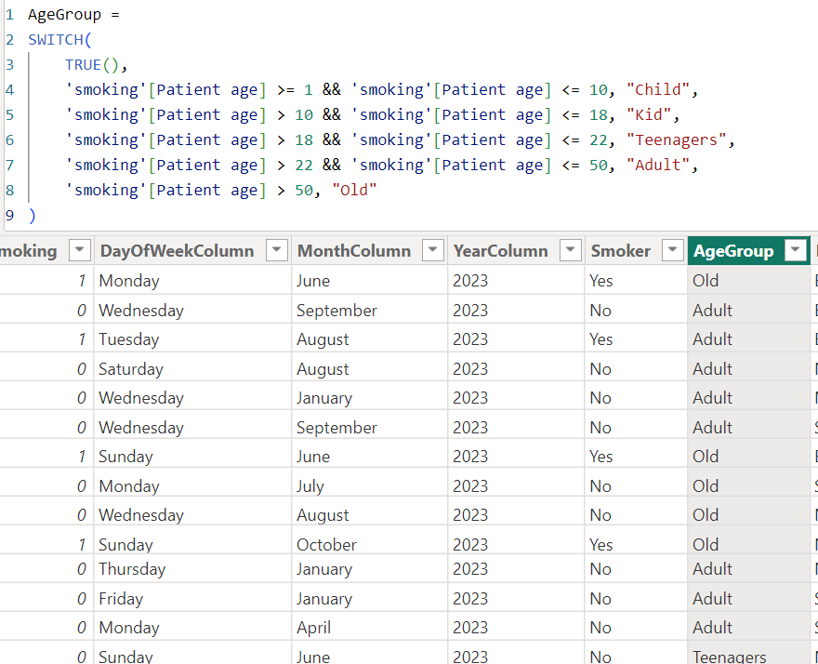
Dax Queries
For Age Group

Slide 6
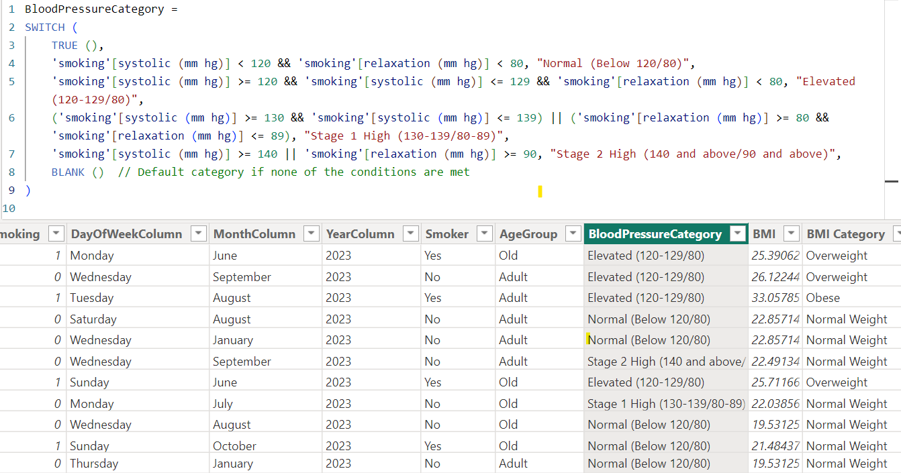
Continue…
For Blood Pressure Category

Slide 7
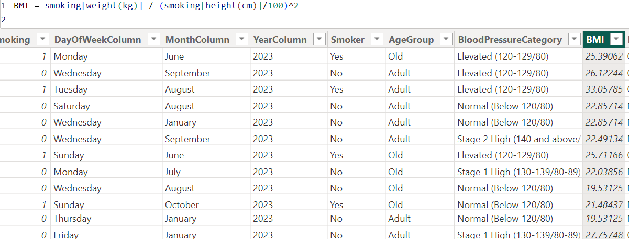
Continue…
BMI

Slide 8
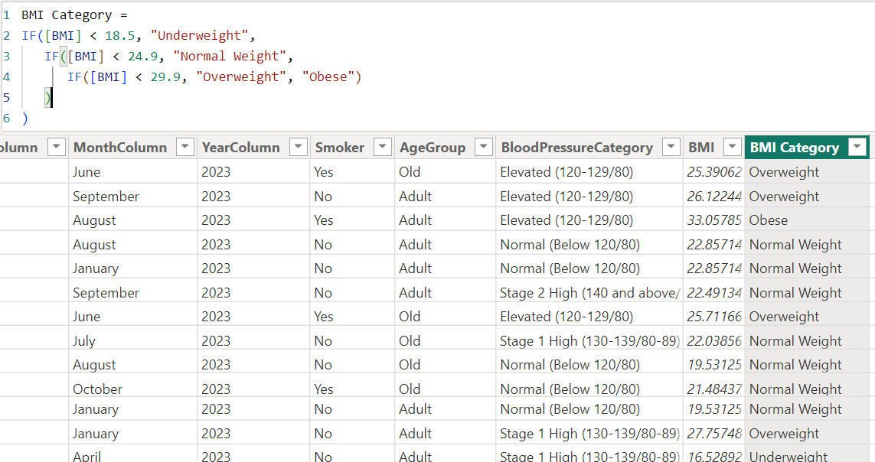
Continue…

Slide 9
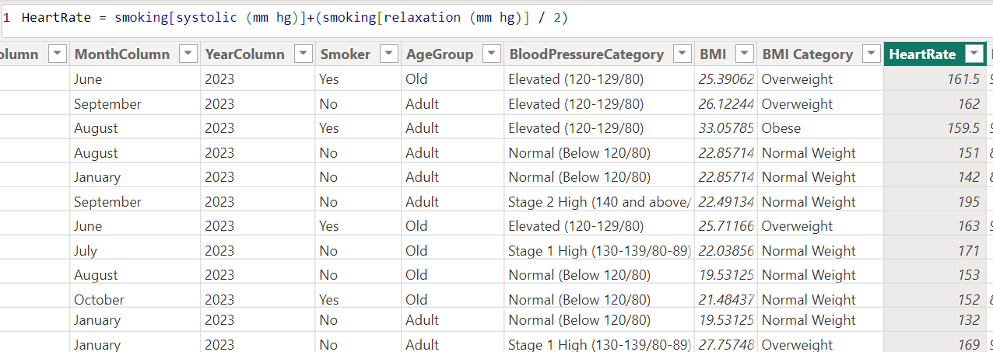
Continue…
Heart Rate

Slide 10
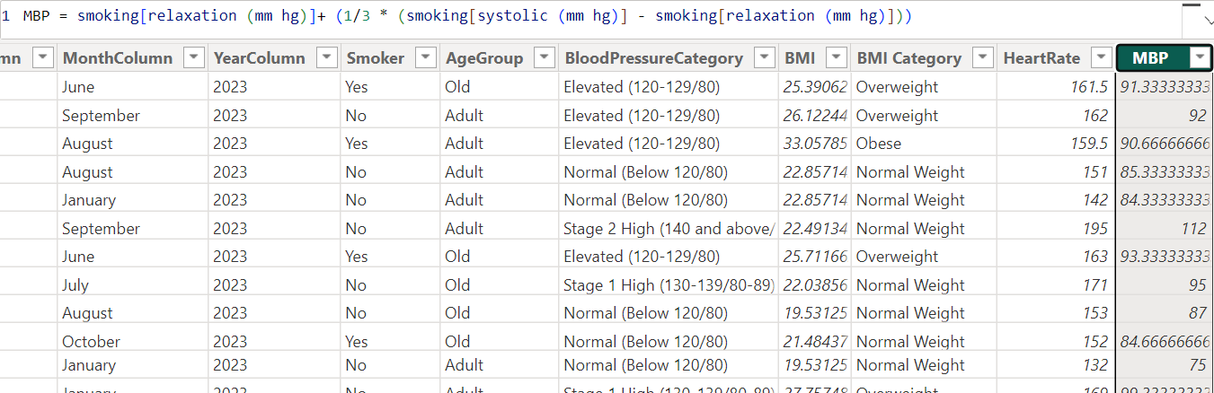
Continue…
Blood Pressure

Slide 11
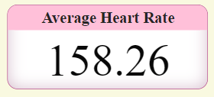
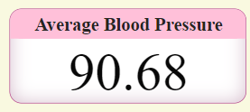
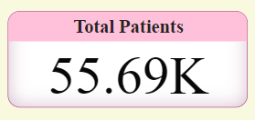
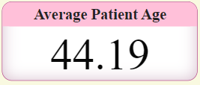
CARDS
Shows the average heart rate of adults
Shows the average blood pressure of adults
Shows the total number of patients in whole data
Shows the average patient age in whole data

Slide 12
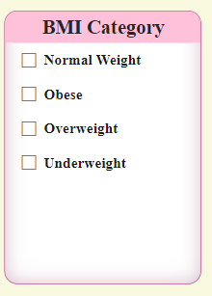
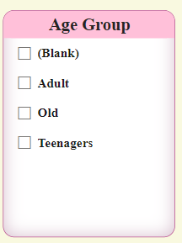
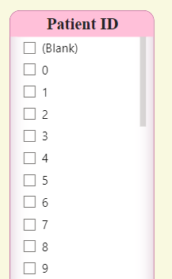
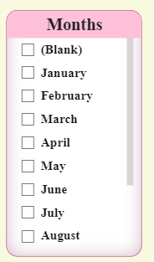
Slicers

Slide 13
PIE CHART
This pie chart shows the distribution of smokers in a dataset
35.23k
25%
Non Smokers
Smokers

Slide 14
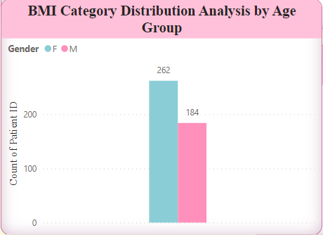
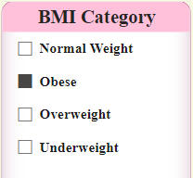
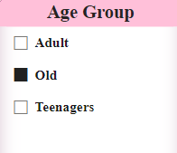
BAR CHART
This Bar Chart shows the distribution of Male and Female Patients by their age groups and BMI category(e.g: old (age group) and obese(BMI group))
262
184
Females that are obese and Old
Males that are obese and old

Slide 15
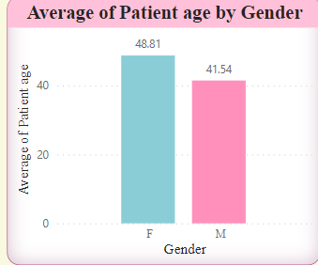
BAR CHART
This Bar chart shows the average patient age by gender
48.81
41.54
Female
Male

Slide 16
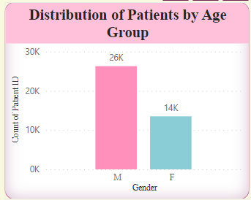
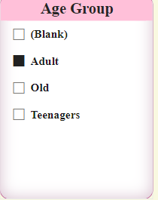
BAR CHART
This Bar Chart shows the distribution of patients by age group (Adult)
26k
14k
Male
Female

Slide 17
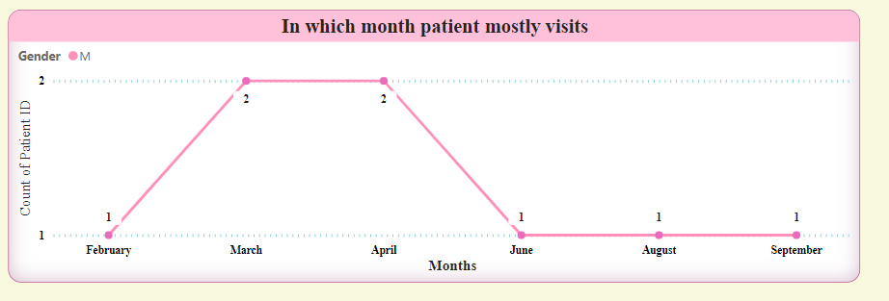
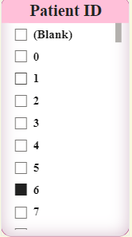
LINE CHART
This line chart shows the months in which the selected patient id mostly visit
We have selected ID no 6.
This shows that ID no 6 visits 2 times in the months of March and April. And one time in January, June, August and September.ID

Slide 18
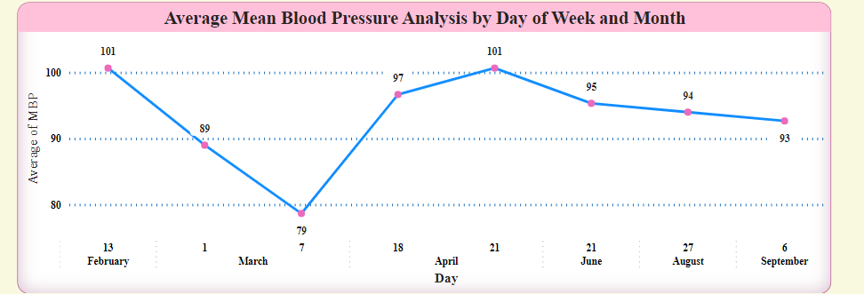
LINE CHART
This line chart shows the months in which the selected patient id Blood Pressure
We have selected ID no 6.
This shows that ID no 6 mean blood pressure on 13th February is 101, on March 1st 89, and so on as shown in graph

Slide 19
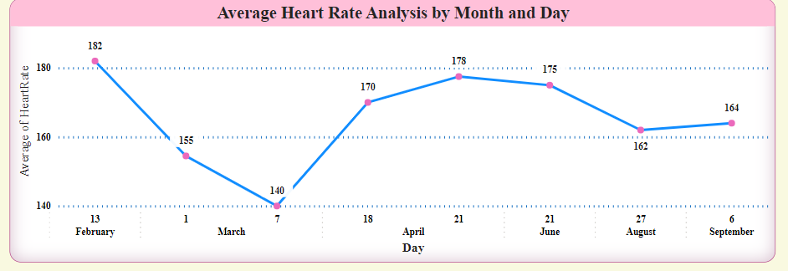
LINE CHART
This line chart shows the months in which the selected patient id Heart Rate
We have selected ID no 6.
This shows that ID no 6 mean blood pressure on 13th February is 101, on March 1st 89, and so on as shown in graph

Slide 20
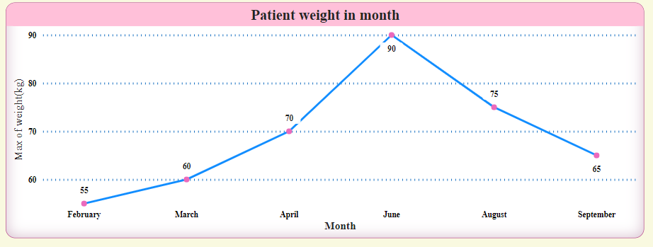
LINE CHART
This line chart shows the months in which the selected patient ID weight in months
We have selected ID no 6.
This shows that ID no 6 weight in February is 55, in March 60, and so on as shown in the graph

Slide 21
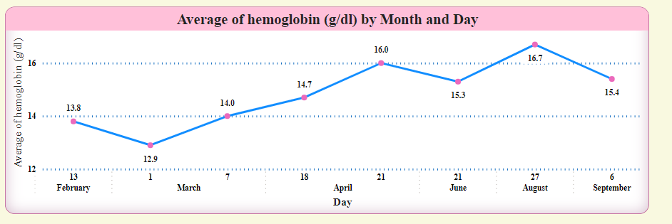
LINE CHART
This line chart shows the months in which the selected patient ID average hemoglobin
We have selected ID no 6.
This shows that ID no 6 average hemoglobin on 13th February is 13.8, and on 21st June is 15.3, and so on as shown in the graph

Slide 22
LINE CHART
This line chart shows the months in which the selected patient ID average hemoglobin
We have selected ID no 6.
This shows that ID no 6 average hemoglobin on 13th February is 13.8, and on 21st June is 15.3, and so on as shown in the graph

Slide 23
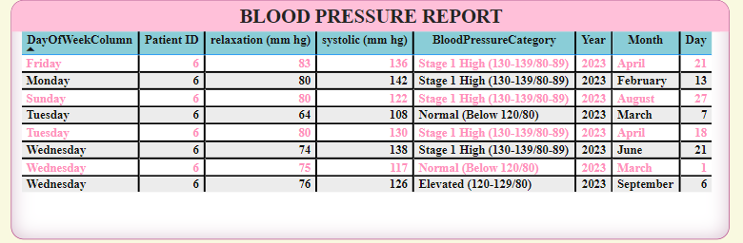
TABLE
Shows blood pressure report of any selected ID
This shows the blood pressure report of ID no 6

Slide 24
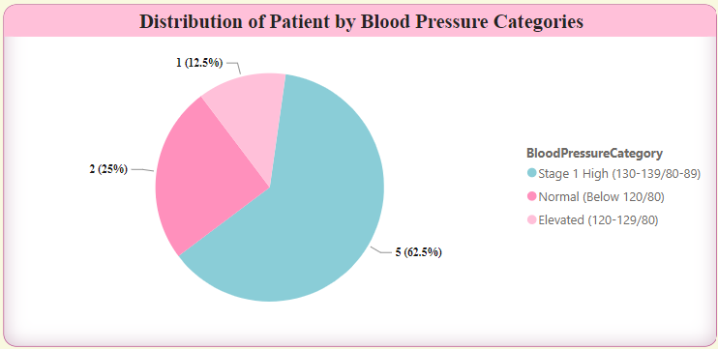
PIE CHART
This pie chart shows the distribution of patient by blood pressure categories. This graph shows the ID no 6 details
12.5%
62.5%
25%
Elevated
Stage 1 high
Normal

Slide 25
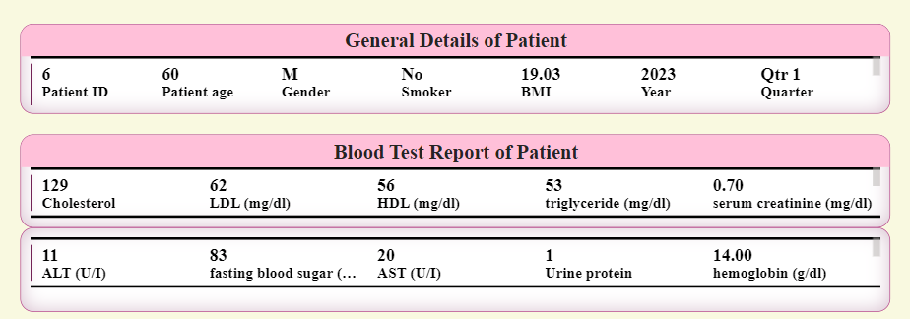
TABLE CHART
This shows the general patient details and blood test report of selected ID (ID no 6)

Slide 26
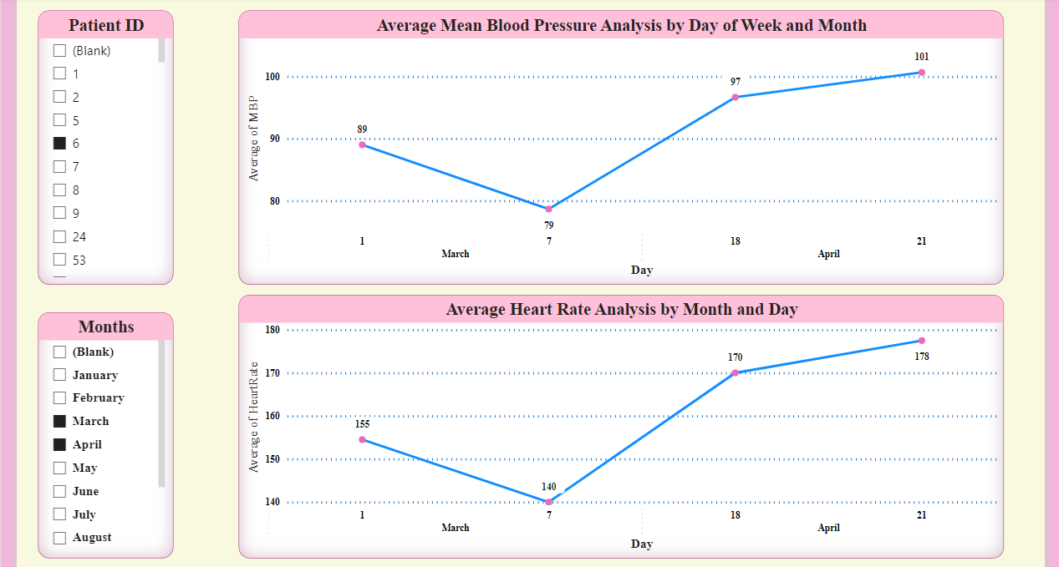
Selection of slicers and results

Slide 27
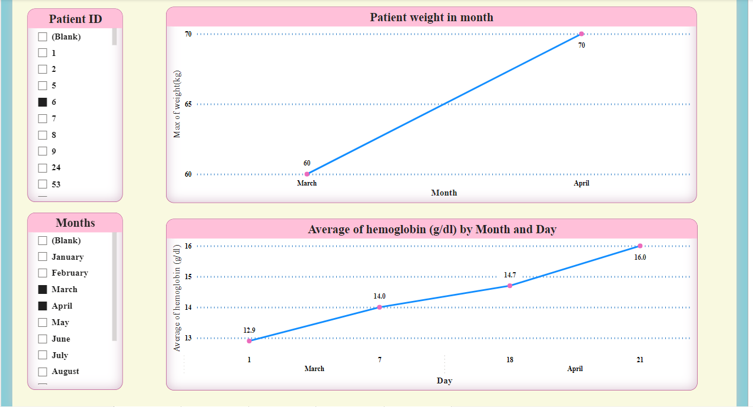
Continue …

Slide 28
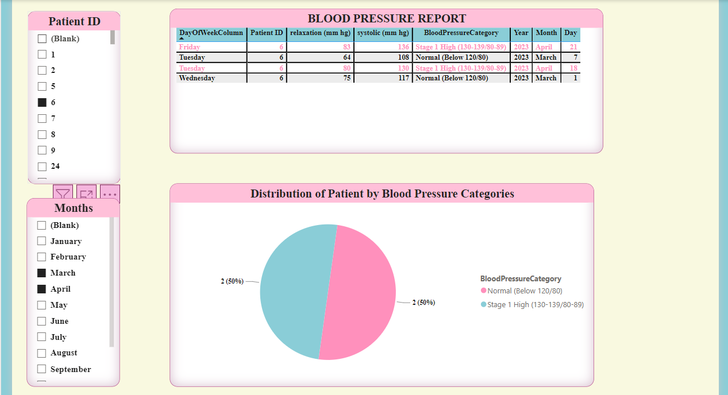
Continue …

Slide 29
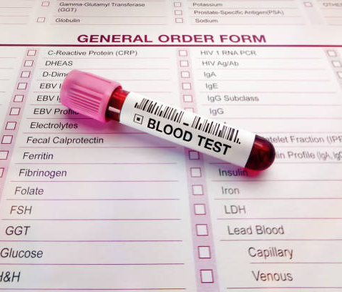
THANK YOU!

